Slide 1
Banking Survey
Friday, July 22, 2016

Slide 2
504
Total Responses
Date Created: Thursday, August 06, 2015
Complete Responses: 477

Slide 3
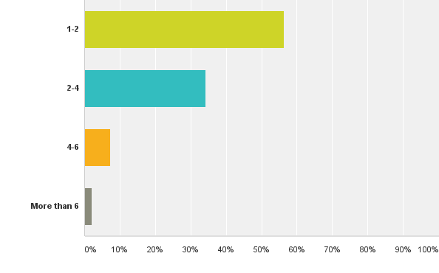
Q1: How many institutions do you have banking products with — including all checking, savings, retirement, mortgage, auto loans, etc.?
Answered: 504 Skipped: 0

Slide 4
Q1: How many institutions do you have banking products with — including all checking, savings, retirement, mortgage, auto loans, etc.?
Answered: 504 Skipped: 0

Slide 5
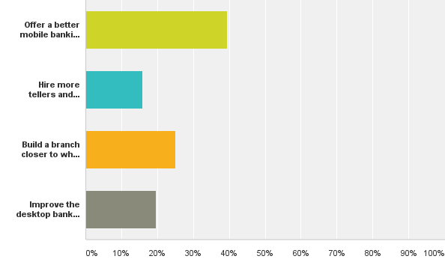
Q2: What is the single best improvement your primary financial institution could make to give you better service?
Answered: 504 Skipped: 0

Slide 6
Q2: What is the single best improvement your primary financial institution could make to give you better service?
Answered: 504 Skipped: 0

Slide 7
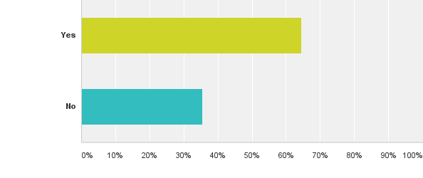
Q3: Have you ever decreased how much you bank somewhere because of a bad experience with a fee?
Answered: 504 Skipped: 0

Slide 8
Q3: Have you ever decreased how much you bank somewhere because of a bad experience with a fee?
Answered: 504 Skipped: 0

Slide 9
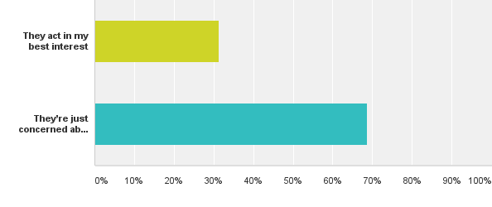
Q4: In your experience, do financial institutions act in your best interest, or are they just concerned about their bottom line?
Answered: 504 Skipped: 0

Slide 10
Q4: In your experience, do financial institutions act in your best interest, or are they just concerned about their bottom line?
Answered: 504 Skipped: 0

Slide 11
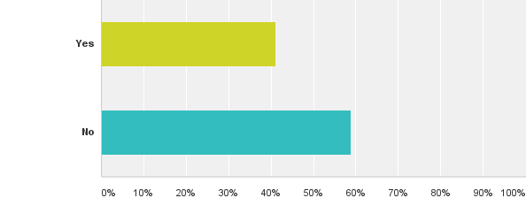
Q5: Do you feel like your primary financial institution actively helps you improve your financial health?
Answered: 504 Skipped: 0

Slide 12
Q5: Do you feel like your primary financial institution actively helps you improve your financial health?
Answered: 504 Skipped: 0

Slide 13
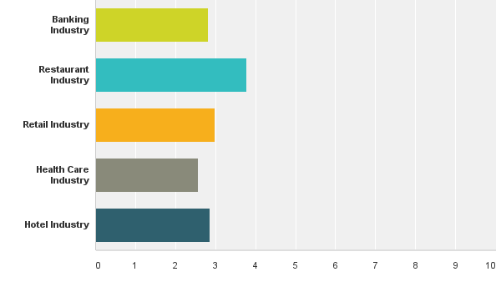
Q6: Rank each industry by how you feel they exceed your expectations of service, with 1 being the best and 5 being the worst.
Answered: 504 Skipped: 0

Slide 14
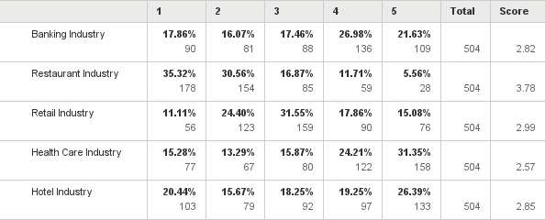
Q6: Rank each industry by how you feel they exceed your expectations of service, with 1 being the best and 5 being the worst.
Answered: 504 Skipped: 0

Slide 15
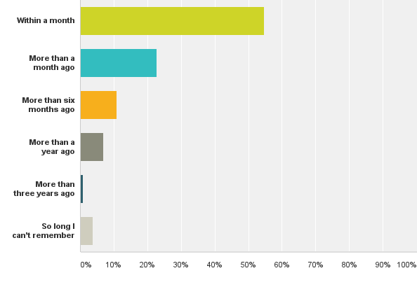
Q7: Which of the following best describes the last time you went into a branch at a bank or credit union?
Answered: 504 Skipped: 0

Slide 16
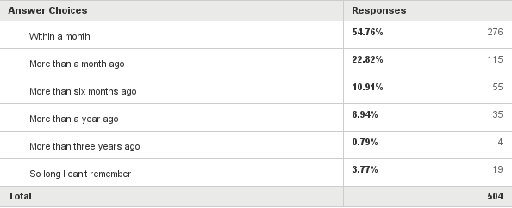
Q7: Which of the following best describes the last time you went into a branch at a bank or credit union?
Answered: 504 Skipped: 0

Slide 17
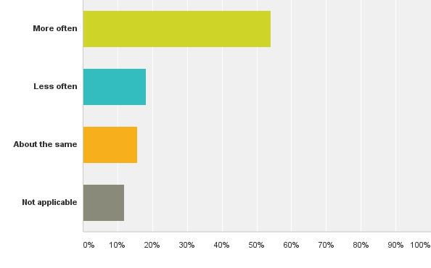
Q8: In the past two years, have you used mobile banking more often or less often?
Answered: 504 Skipped: 0

Slide 18
Q8: In the past two years, have you used mobile banking more often or less often?
Answered: 504 Skipped: 0

Slide 19
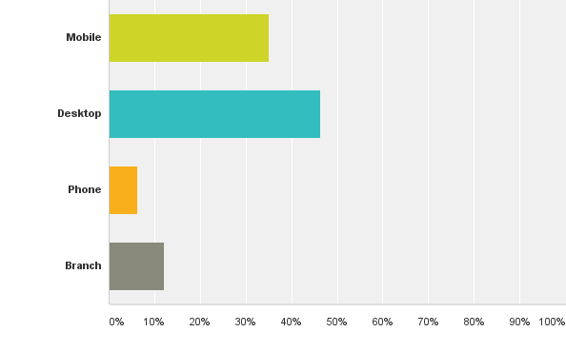
Q9: What channel do you most prefer to use for banking?
Answered: 504 Skipped: 0

Slide 20
Q9: What channel do you most prefer to use for banking?
Answered: 504 Skipped: 0

Slide 21
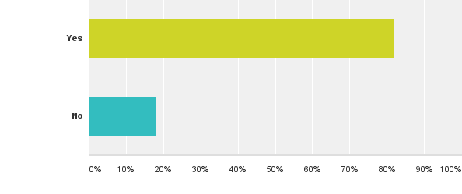
Q10: If a tech company like Google or PayPal offered banking services such as payments or loans, would you consider using those features?
Answered: 504 Skipped: 0

Slide 22
Q10: If a tech company like Google or PayPal offered banking services such as payments or loans, would you consider using those features?
Answered: 504 Skipped: 0

